Slide 1


Digital Annealer
Presenter: Cheng-Han Hsieh, Ting-Yi Wu
Team 11
https://github.com/r08943099/MSOCFall2020/tree/main/final_project

Slide 2
Outline
Introduction
Operating principle
Application Example
Evaluation Results
High level synthesis
Conclusion
Reference

Slide 3
Introduction

Slide 4
Introduction
A Digital Annealer (DA) is a dedicated architecture for high-speed solving of combinatorial optimization problems mapped to an Ising model.
Fully coupled bit connectivity
High coupling resolution
Uses Markov Chain Monte Carlo as a basic search mechanism
Accelerated by the hardware implementation of multiple speed-enhancement techniques
Parallel search
Escape from a local solution
Replica exchange
Combinatorial optimization problem
Ising model
The Energy Function equal tp the QUBO form of problem

Slide 5
Ising model
Statistical model representing the spin
Atomic spins in two states(+1 or -1)
+1 : up
-1 : down
Two procedures:
Anneling:
State transition that lowers the local energy by the interaction with adjacent spins
Random flip:
A stochastic state transition to help escape from local minima

Slide 6
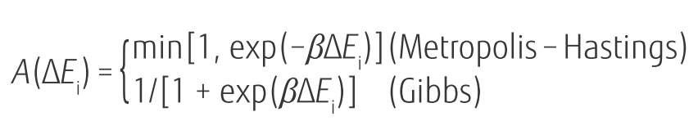
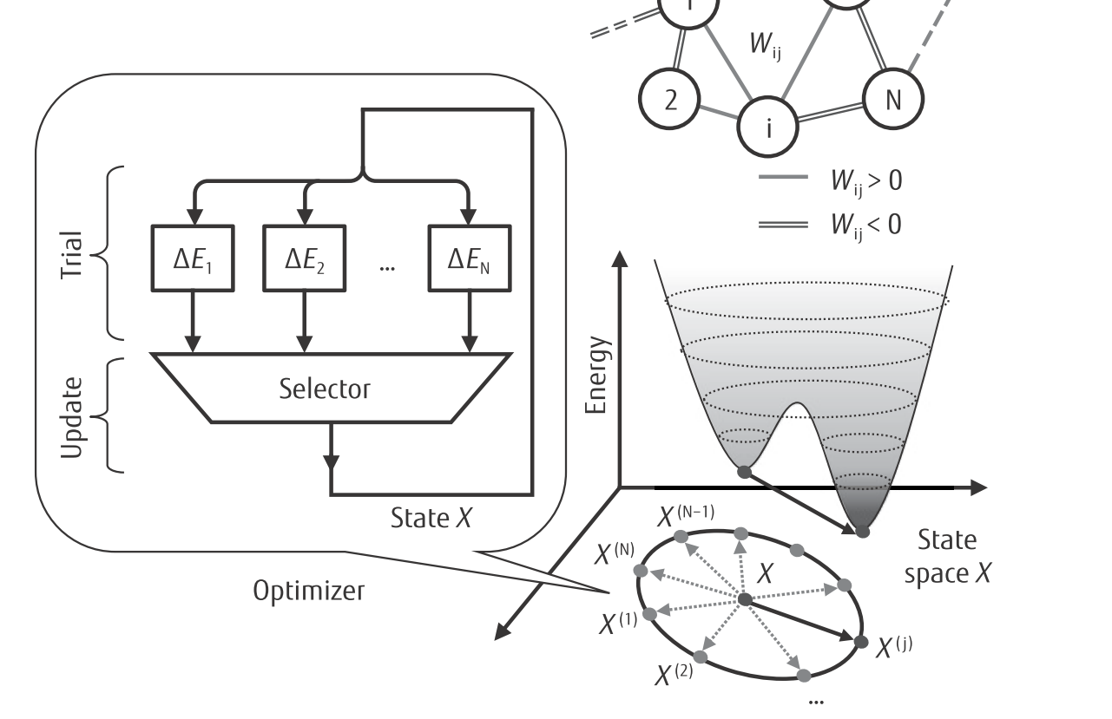
Operating steps
Two phases
Trial phase
state-variable change that meets an acceptance criterion is selected
Update phase
selected variable is flipped and relevant signals that depend on the variable are updated accordingly
Notes:
選擇滿足驗收標準的狀態變量更改

Slide 7
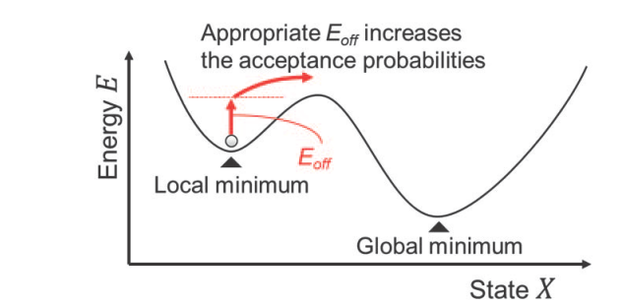
Escape from a local solution
When the state is at a local minimum of the Ising energy function, the probability of moving to a new state is small.
Slows convergence

Slide 8
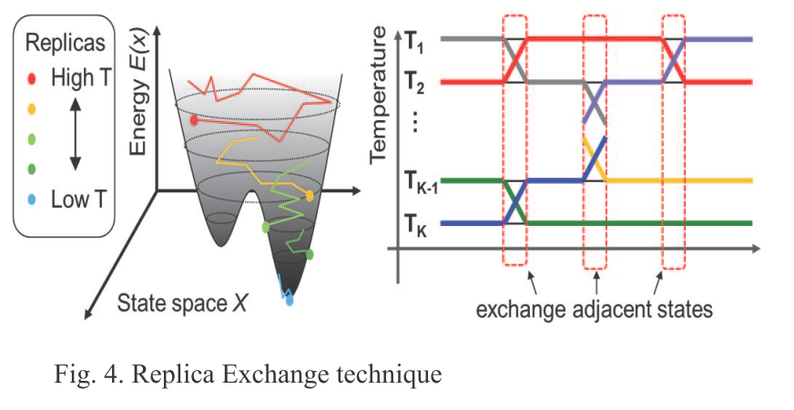
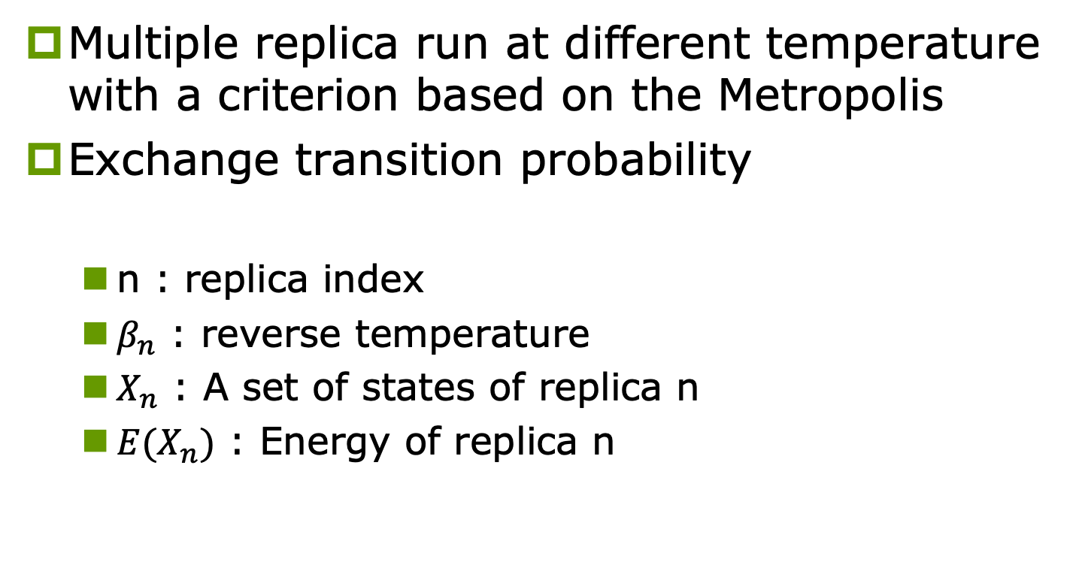
Replica exchange
Multiple replica run at different temperature with a criterion based on the Metropolis
Exchange transition probability
n : replica index
$β_{n}$ : reverse temperature
$X_{n}$ : A set of states of replica n
${E(X}_{n})$ : Energy of replica n

Slide 9

DA Operation Review
Given an problem: 4 city TSP
Convert to ising model
$$\left[\begin{matrix}0 & 0 & 0 & 0 \\ 0 & 0 & 0 & 0 \\ 0 & 0 & 0 & 0 \\ 0 & 0 & 0 & 0\end{matrix}\right]$$
Assume this is initial state

Slide 10









DA Operation Review (cont.)
Trial phase (Parallel)
16 spins need trial
Candidates
$$\left[\begin{matrix}1 & 0 & 0 & 0 \\ 0 & 0 & 0 & 0 \\ 0 & 0 & 0 & 0 \\ 0 & 0 & 0 & 0\end{matrix}\right]$$
Random choose and update phase
(if at local minimum add Eoff)
$$ΔE$$
ADB
$$\left[\begin{matrix}0 & 0 & 0 & 0 \\ 0 & 0 & 0 & 0 \\ 0 & 0 & 0 & 0 \\ 0 & 0 & 0 & 0\end{matrix}\right]$$
$$\left[\begin{matrix}0 & 1 & 0 & 0 \\ 0 & 0 & 0 & 0 \\ 0 & 0 & 0 & 0 \\ 0 & 0 & 0 & 0\end{matrix}\right]$$
$$ΔE$$
ADB
$$\left[\begin{matrix}0 & 0 & 1 & 0 \\ 0 & 0 & 0 & 0 \\ 0 & 0 & 0 & 0 \\ 0 & 0 & 0 & 0\end{matrix}\right]$$
$$ΔE$$
ADB
………….
$$\left[\begin{matrix}0 & 0 & 0 & 0 \\ 0 & 0 & 0 & 0 \\ 0 & 0 & 0 & 0 \\ 0 & 0 & 0 & 1\end{matrix}\right]$$
$$ΔE$$
ADB

Slide 11
DA Operation Review (cont.)
Replica exchange
Above operations will parallel run with different temperature
After one update, exchanging replica with probability

Slide 12
Application Example: TSP

Slide 13
TSP
n-cities are modeled by a lattice-like graph that uses n²
City number
Visit order
The objective function is formulated as the summation of the distances along the route and the number of constraint violations.

Slide 14
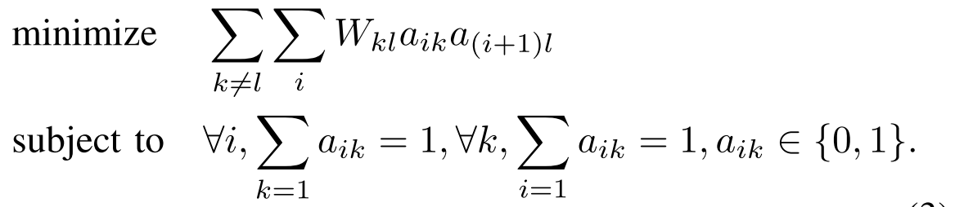
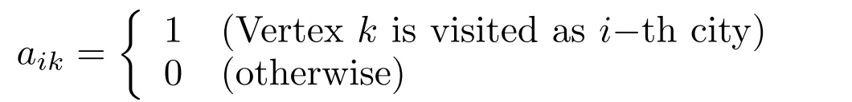
TSP(cont.)
A n-vertices TSP is formulated as:
a_{ik} : vertex k is (is not) visited as the i-th city when a_{ik} = 1(0)
W_{kl} : the weight (or distance) between vertices k and l
Possible routes is (n - 1)! / 2
Difﬁcult to obtain its optimal solution by brute force methods as n becomes larger.

Slide 15
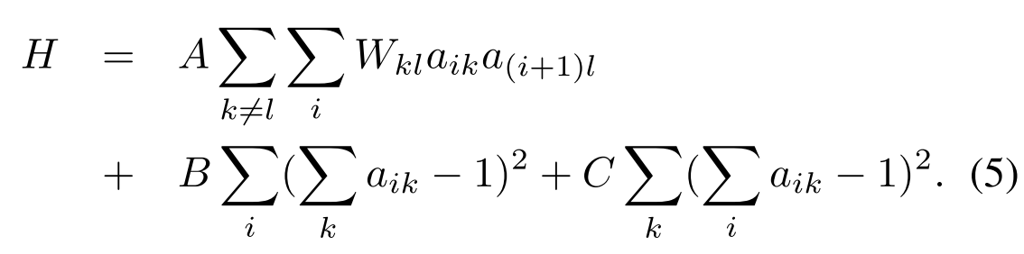
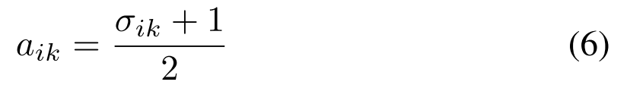
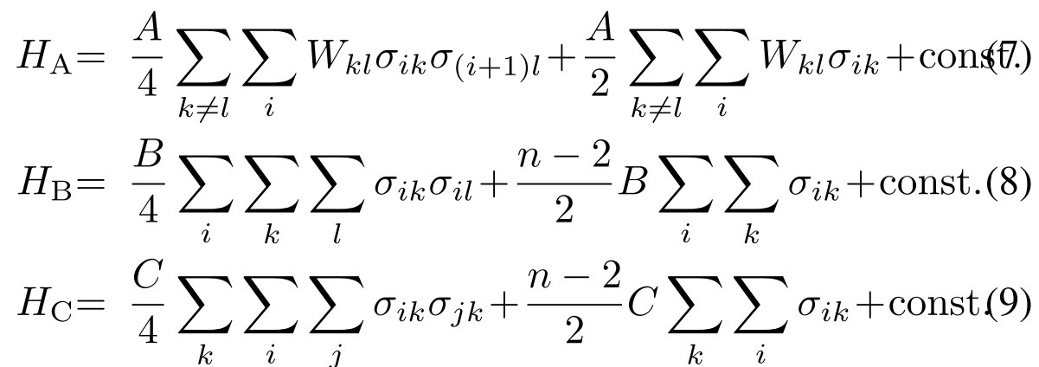
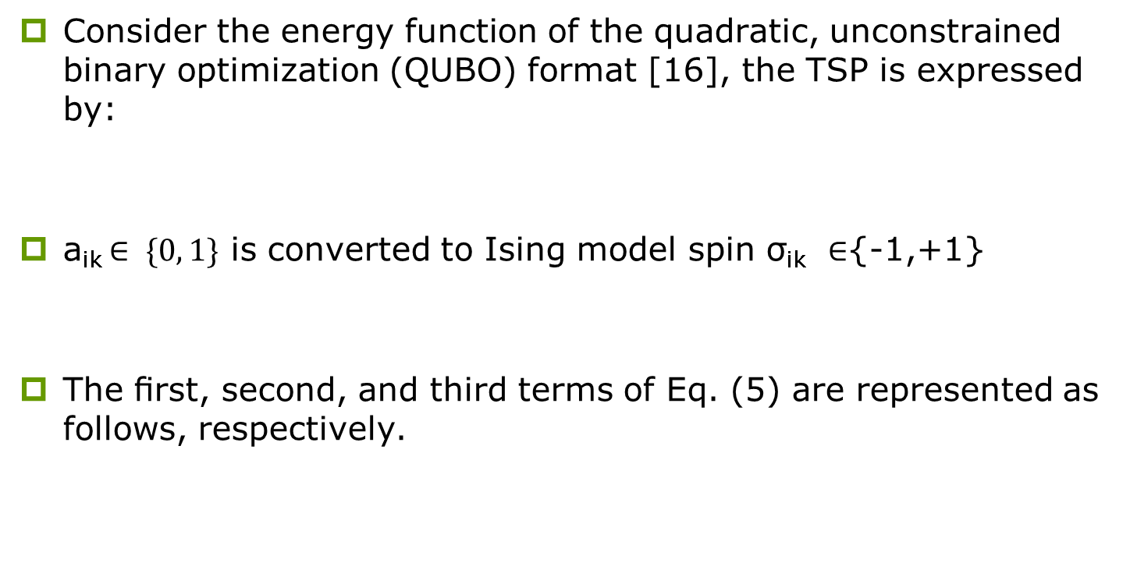
Mapping
Consider the energy function of the quadratic, unconstrained binary optimization (QUBO) format [16], the TSP is expressed by:
a_{ik} $∈ \{0, 1\}$ is converted to Ising model spin σ_{ik} ∈{-1,+1}
The ﬁrst, second, and third terms of Eq. (5) are represented as follows, respectively.
penalty(visit vertex i twice or more )
objective function penalty(visit several at the same time)

Slide 16
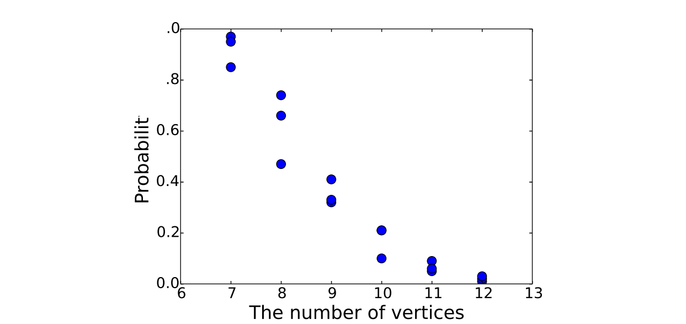
Issues discussion
The graph becomes quadratically large
Solutions fail to satisfy the constraints with quality
If the constraint term is emphasized, the solution quality will signiﬁcantly deteriorate
Naïve Ising model solvers are used, the probability of obtaining an optimal solution is very low for TSPs of any useful size.

Slide 17
Evaluation Results (TSP LIB)

Slide 18
HLS

Slide 19
Hardware target overview
For each iteration:
Replica 1
Replica 2
Replica exchange
Update best
Replica N

Slide 20
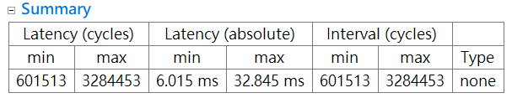
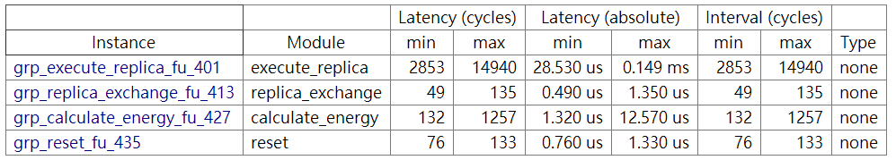
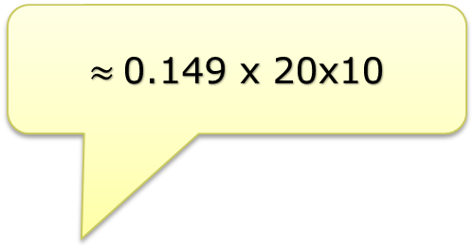
Fail to parallel in previous work
Replica : 20
Iteration : 10
$≈$0.149 x 20x10

Slide 21
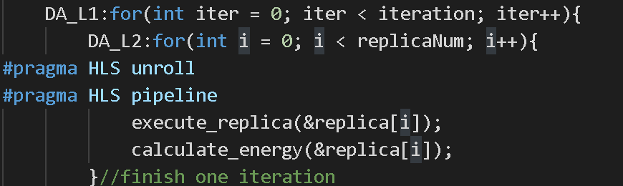
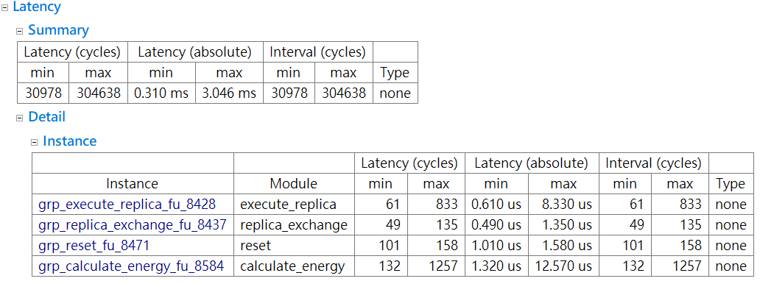
Fail to parallel in previous work(cont.)
Fail to improve 20X
Just 10X

Slide 22
Replica exchange scheme
In replica exchange scheme, we can parallel execute with different temperature settings.
Since the Data structure in Baseline, it cannot implement the parallel scheme
What we imagine
Parallel
Actually
Sequential
replica1
replica2
replica1
replica2
replica3
replica3

Slide 23
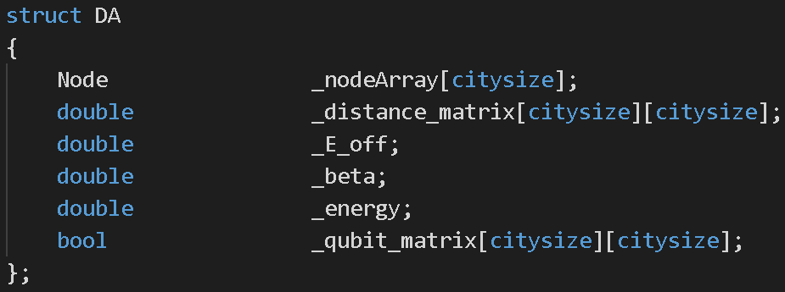
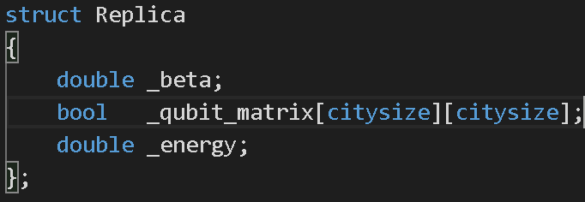
The Data structure bottleneck
All operation will through structure DA to do the operation
For each replica, they will copy qubit matrix to da.qubit_matrix
Each function rely on da.qubit_matrix to opreate
Cause cannot do parallel

Slide 24
Rebuild the Data Structure
Delete the DA structure
Each function rely on replica.qubit_matrix to operate
Possible to do parallel

Slide 25
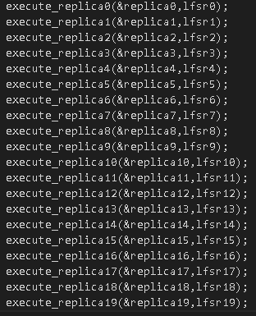
Baseline
Force all execute_replica() be individual
Copy this function to N copies
Will do parallel?
So inconvenience…

Slide 26
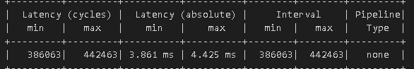
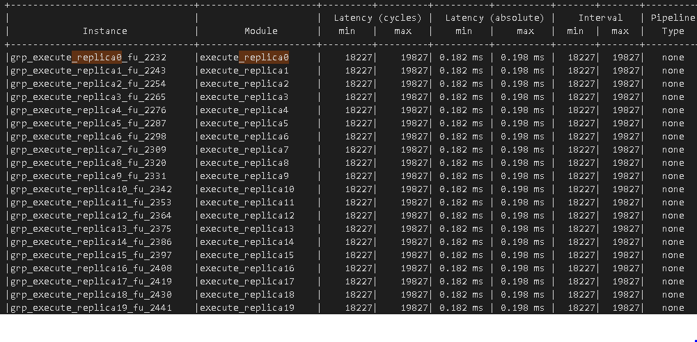

Success to parallel replica scheme
Replica : 20, Iteration : 20
$≈$0.198*20
Parallel

Slide 27
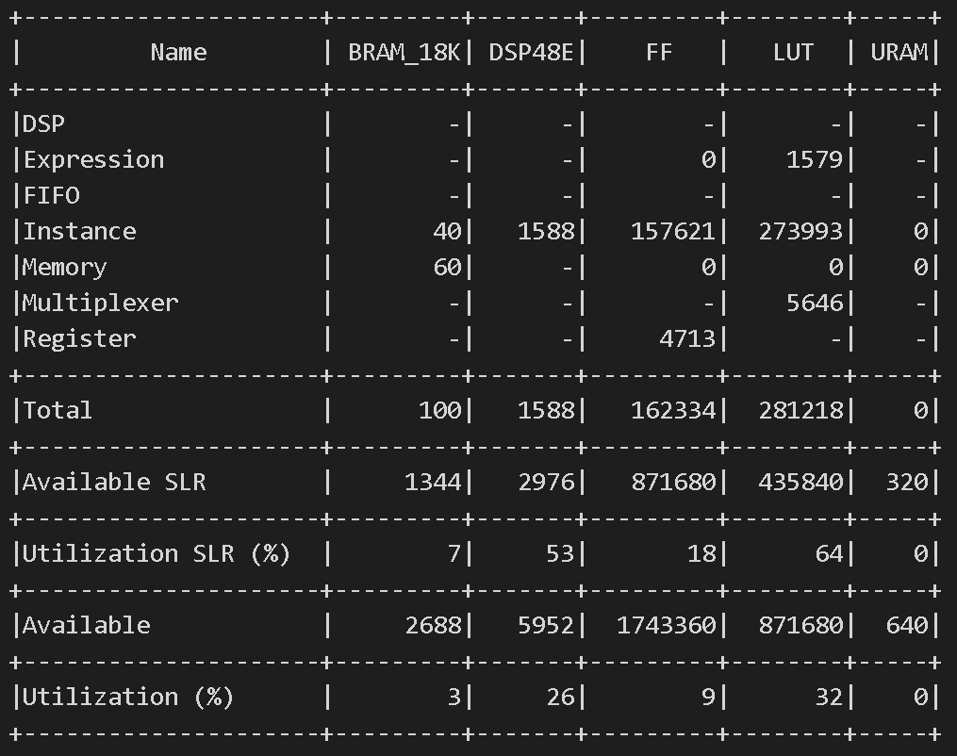
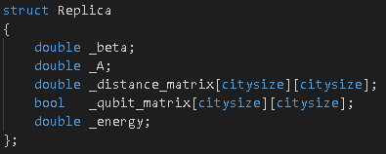
Success to parallel replica scheme(cont.)
Solution: Make sure each replica has a copy from some constant value
E.g. Distance Matrix, parameter
Cons: More hardware
Parallel all replicas
Some Common
Datum should have N copies

Slide 28
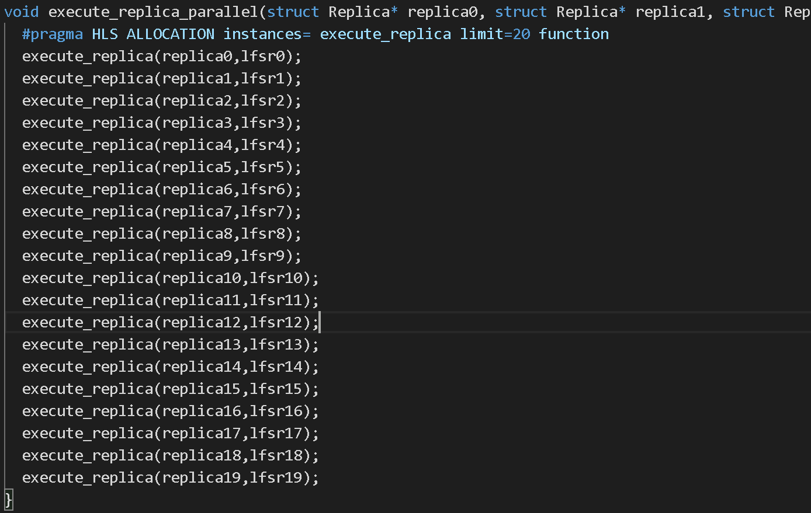
#pragma HLS allocation
By default, HLS tries to save resources by using the function multiple times
Same performance with good coding format

Slide 29
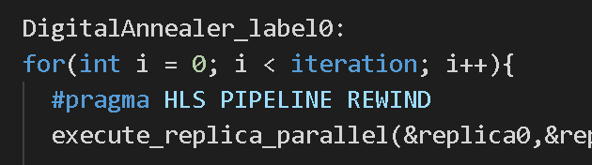
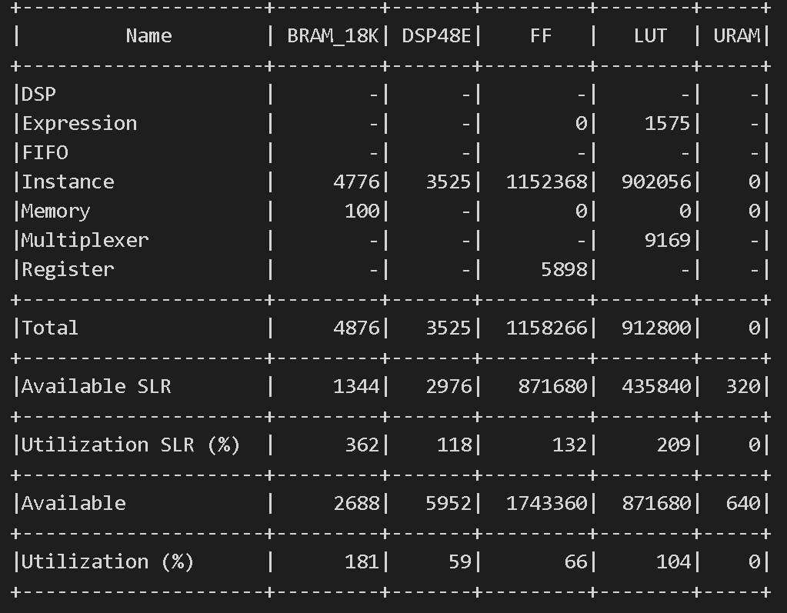
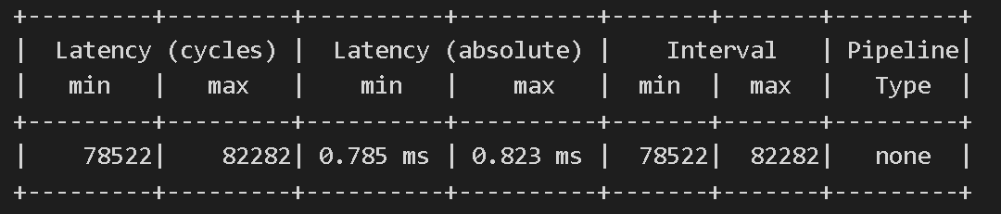
#pragma HLS pipeline rewind
Use pipeline for each iteration
Latency improves, but source over usage

Slide 30
Other prama
In the design, it needs to use many matrices to operate
Array partition
In the replica exchange scheme, we use the same function simultaneously. But in the HLS tool, it consider there are same instance.
Function Inline with template

Slide 31

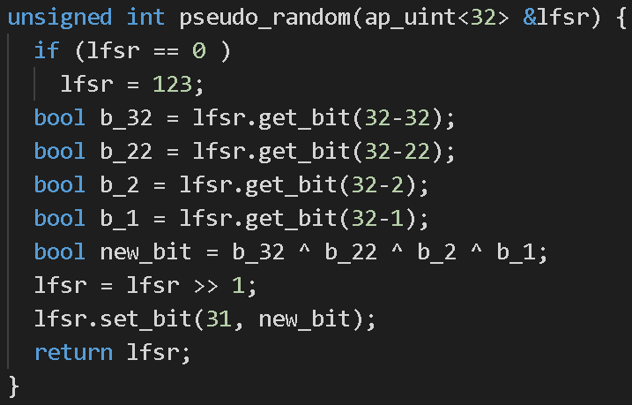
Pseudo random generator
The function finish by LFSR
Declare the seed

Slide 32
Cosim Error message solved
Error:
Just need to adjust the script file
Before : cosim_design
After :cosim_design -trace_level all -tool xsim

Slide 33
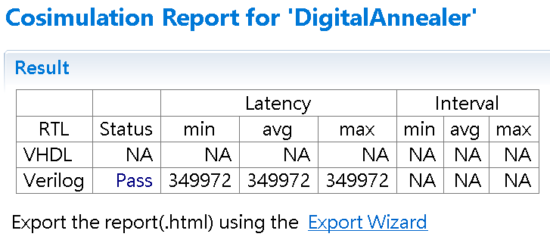
Cosim Result

Slide 34
Conclusion

Slide 35
Conclusion
We implement digital annealer into synthesizable C code.
Perform HLS on the design and improve the latency
Achieve full parallel by HLS

Slide 36
The end and Q&A

